Slide 1
Computer Architecture
CSE-321

Slide 2
Reference Book
Computer Organization & Design (2nd or 4th edition)
- David A. Patterson and John L. Hennessy

Slide 3
What is Computer Architecture?
Computer Architecture is the theory behind the operational design of a computer system
This is a term which is applied to a vast array of computer disciplines ranging from low level instruction set and logic design, to higher level aspects of a computer’s design such as the memory subsystem and bus structure
Computer architecture is the science and art of selecting and interconnecting hardware components and designing the hardware/software interface to create a computer that meets functional, performance, energy consumption, cost, and other specific goals.

Slide 4


Why Computer Architecture?
People and computer are different !!!
=

Slide 5


Why Computer Architecture?
Slave
Master

Slide 6
Why Computer Architecture?
Convenient for Human
translation or interpretation
Convenient for Computer
execute

Slide 7
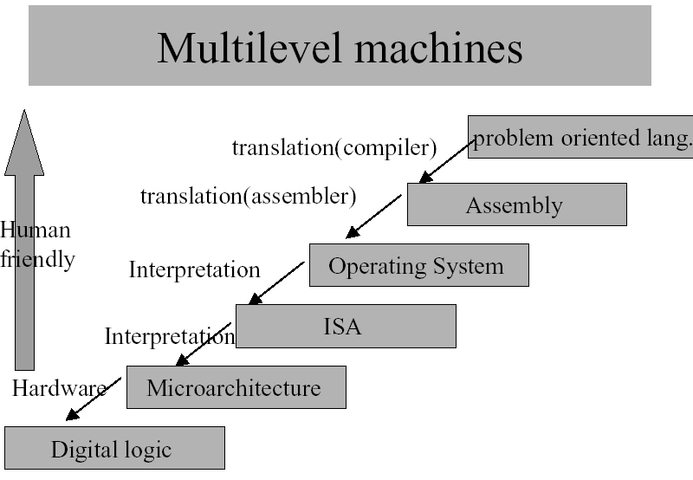

Slide 8

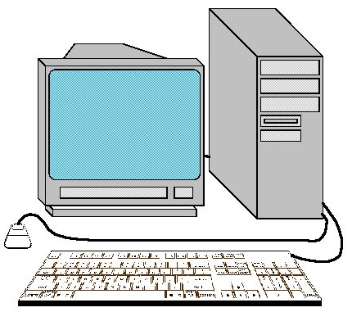
Below Your Program
High Level Language
A + B
C Compiler
Assembly Language
add A, B
Assembler
0 1
1000110010100000
Machine Language

Slide 9
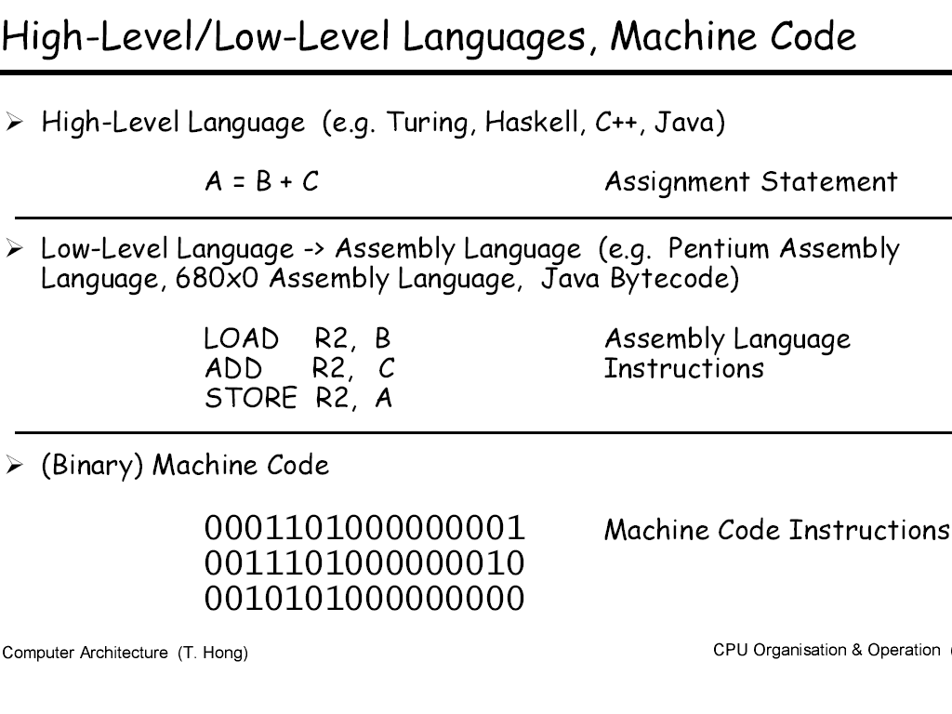
Below Your Program

Slide 10
Advantages of
High-Level Languages
They allow the programmer to think in a more natural language.
Improves programmer’s productivity.
Allow programs to be independent of the computer

Slide 11
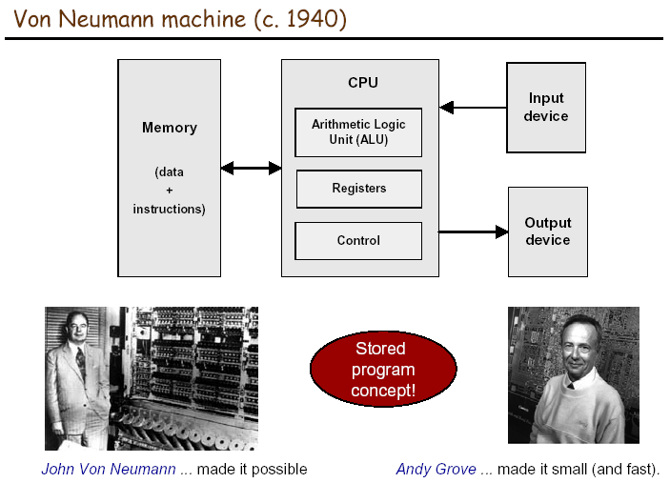

Slide 12
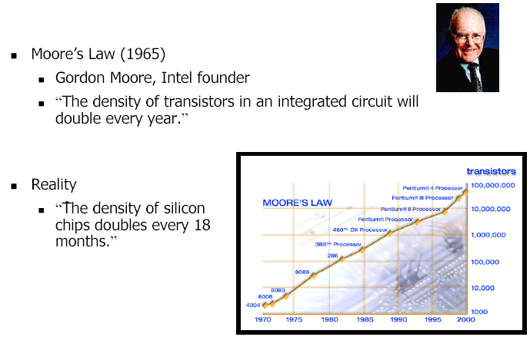
Moore’s Law

Slide 13
Thank You !!!

